Slide 1
Geometric constraints on human brain function
Zilong Wang

Slide 2
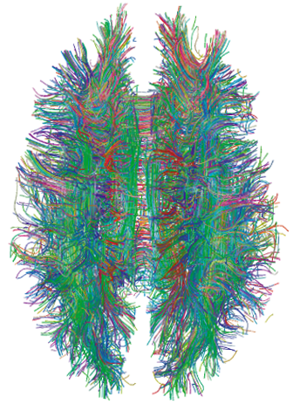
Introduction
Structure determines function --> which structure? Geometry or connectome / interregional connectivity?
Classical connectome assumes that spatiotemporal neural activity (spike train, waveforms, neural dynamics, EEG/MEG) arise from interactions between discrete, functionally specialized cell populations connected by a topologically complex array of short- and long-range axonal connections. dMRI yield a structural connectivity matrix called a connectome, but connectome doesn’t directly account for brain’s physical property and spatial embedding (geometry and topology). For example, brain’s fist-like shape and curvature.
Neural field theory (NFT) a mathematical framework that models brain activity as a superposition of travelling waves of excitation that propagate continuously through neural tissue. In this theory, neural interactions between different cortical locations are approximated by a homogeneous spatial kernel that declines roughly exponentially with distance. → two regions further apart, less interaction between them exponentially.
Notes:
So basically, if you flatten the 3D cortex into a 2d sheet, the neural activity is like a ripple in a pond that propagates from the center to everywhere but gradually decreases. But then, different shapes of the cortices will result in different shapes of the sheets.

Slide 3
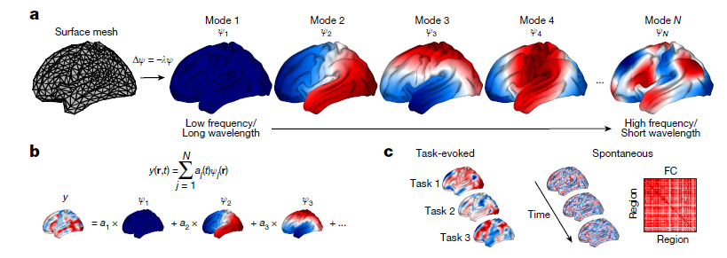
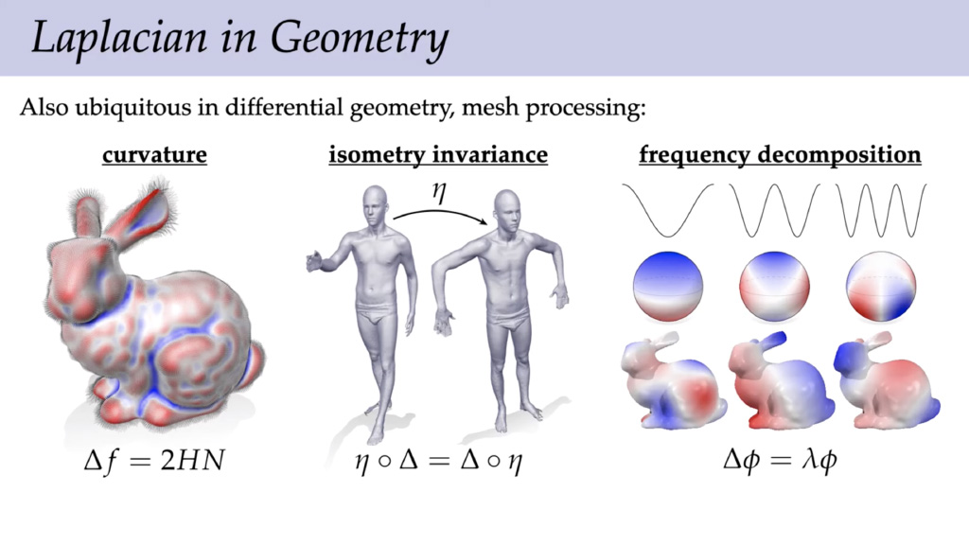
Deriving the eigenmodes
Geometry can be understood by eigenmodes of brain’s shape, curvatures and contours.
Population averaged neocortex template - 3D surface mesh
Laplace–Beltrami operator (LBO) to capture local vertex-to-vertex spatial relations and curvature, and solve the eigenvalue problem (fig a) → the red (positive), blue (negative) and white (zero) values for every vertex represent the spatial relationship and curvature.
Each mode is just an eigenvector that can be used to transform the individual neural activity matrix.
Notes:
Here the wavelength, or spatial wavelength refers to over how much distance a wave’s pattern repeats itself. First, lets again flatten the cortex into a sheet, which is actually a Riemannian sheet, and each vertex has a place on that sheet. If you see the darkness of blue and red as the amplitude of negative and positive values, you can see the wave across the brain.

Slide 4


Reconstructing individual neural activity
Here the red and blue of a vertex represent the reconstructed neural activity of that vertex, different from the previous slide. DON’T CONFUSE THE TWO!!
Task-based fMRI
Resting-state fMRI across time
Actual
Reconstructed y’
Notes:
In Fig b, y is the actual neural activity, a_j is the unknown weight of mode_j in explaining the neural activity, which is what to be computed by integrating over all the vertices of the cortex. After getting a_j from equation 5, a_j will be used in Fig b’s equation to obtain reconstructed neural activity y’ in Fig c, which feels a bit weird and seems to be circular inference?

Slide 5
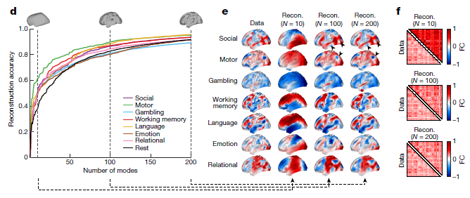
results
Notes:
The modes are ordered from spatial patterns with a low frequency and long wavelength (global fluctuations) to those with a high frequency and short wavelength (local, fine-detailed fluctuations)
reconstruction accuracy for task-free data in fig f was calculated by taking the correlation of the upper triangular elements of the empirical and reconstructed FCs. For task-evoked data in fig d and e, reconstruction accuracy was calculated from the spatial correlation of parcellated empirical and reconstructed maps. We then took the average reconstruction accuracy across all participants.

Slide 6
The surprisingly long-wavelength content of task-activation data (Fig. 1d–e) suggests that classical procedures focus only on the tips of the iceberg and obscure the underlying spatially extended and structured patterns of activity evoked by the task.

Slide 7
Reconstruction of individual cortical activity map?
After getting eigenmodes, do they apply the eigenmodes to the intact individual map to get individualized eigenmodes, and then somehow add these individualized modes back together? I think so yes.

Slide 8
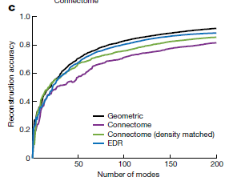
limitation
Comparison of connectomic and geometric: is it appropriate to find the connectomic eigenmodes? What even are the eigenmodes of connectome? Ideally, the connectome should only map the anatomical connection between vertices and why should there be some eigen connections?
The study only focus on one hemisphere, but corticocortical tracts often cross hemispheres and are not unilateral. Thus the unilateral eigenmode of connectome could lose a lot of information? Which is why the benchmark is so low.

